Slide 1
CSE 445 Lecture 9
Support Vector Machine

Slide 2
Support Vector Machine
A Support Vector Machine (SVM) is a very powerful and versatile Statistical Pattern Recognition model
It can perform linear or nonlinear classification, regression, and even outlier detection

Slide 3
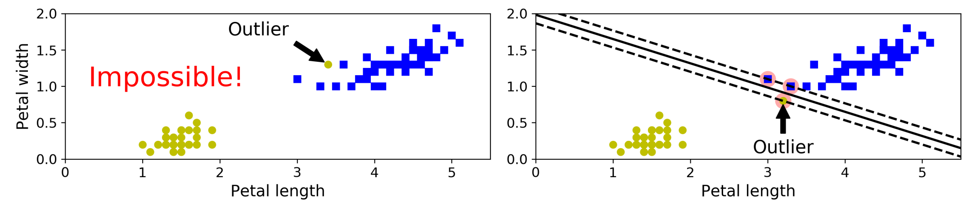
Maximum Margin Classifier
If we strictly impose that all instances be off the street and on the right side, this is called hard margin classification
There are two main issues with hard margin classification
It only works if the data is linearly separable
It is quite sensitive to outliers

Slide 4
Support Vectors
The samples on the edge of the boundary lines , are known as ‘Support Vectors
Support Vectors are the samples that are most difficult to classify
They directly affect the process to find the optimum location of the decision boundaries
Only a very small subset of training samples (Support vectors) can fully specify the decision function
If the Support Vectors are removed from the data set, it will potentially change the position of the dividing line

Slide 5
Maximum Margin Classifier
In Scikit-Learn’s SVM classes, we can control this balance using the C hyperparameter: a smaller C value leads to a wider street but more margin violations
Next figure shows the decision boundaries and margins of two soft margin SVM classifiers on a nonlinearly separable dataset
On the left, using a low C value the margin is quite large, but many instances end up on the street
On the right, using a high C value the classifier makes fewer margin violations but ends up with a smaller margin
However, it seems likely that the first classifier will generalize better: in fact even on this training set it makes fewer prediction errors, since most of the margin violations are actually on the correct side of the decision boundary

Slide 6
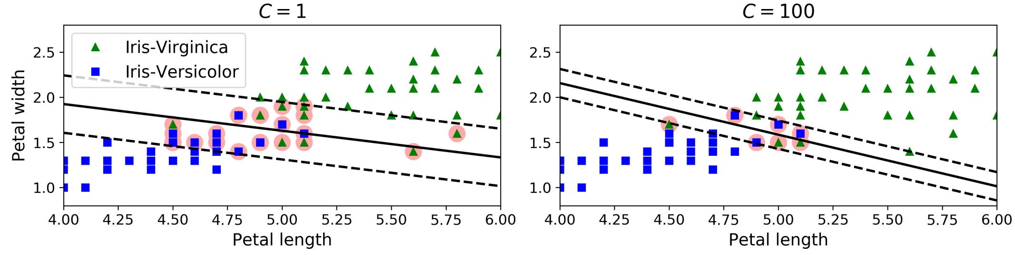
Soft margin

Slide 7
Code for the petal length classification
import numpy as np
from sklearn import datasets
from sklearn.pipeline import Pipeline
from sklearn.preprocessing import StandardScaler
from sklearn.svm import LinearSVC
iris = datasets.load_iris()
X = iris["data"][:, (2, 3)] # petal length, petal width
y = (iris["target"] == 2).astype(np.float64) # Iris-Virginica
svm_clf = Pipeline([
("scaler", StandardScaler()),
("linear_svc", LinearSVC(C=1, loss="hinge")),])
svm_clf.fit(X, y)

Slide 8
Implementation notes
The LinearSVC class regularizes the bias term
So, data need to be centered around the mean
Here StandardScaler does it for us automatically
We could use the SVC class, using SVC(kernel="linear", C=1),
Just using different implementation
but it is much slower, especially with large training sets, so it is not recommended
Another option is to use the SGDClassifier class, with SGDClassifier(loss="hinge",alpha=1/(m*C))
This applies regular Stochastic Gradient Descent to train a linear SVM classifier
It does not converge as fast as the LinearSVC class, but it can be useful to handle huge datasets that do not fit in memory (out-of-core training), or to handle online classification tasks

Slide 9
α
Linear Classifiers
x
f
y^{est}
f(x,w,b) = sign(w x + b)
denotes +1
denotes -1
w x + b>0
w x + b=0
How would you classify this data?
w x + b<0

Slide 10
α
Linear Classifiers
x
f
y^{est}
f(x,w,b) = sign(w x + b)
denotes +1
denotes -1
How would you classify this data?

Slide 11
α
Linear Classifiers
x
f
y^{est}
f(x,w,b) = sign(w x + b)
denotes +1
denotes -1
How would you classify this data?

Slide 12
α
Linear Classifiers
x
f
y^{est}
f(x,w,b) = sign(w x + b)
denotes +1
denotes -1
Any of these would be fine..
..but which is best?

Slide 13
α
Linear Classifiers
x
f
y^{est}
f(x,w,b) = sign(w x + b)
denotes +1
denotes -1
How would you classify this data?
Misclassified
to +1 class

Slide 14
α
α
Classifier Margin
Classifier Margin
x
x
f
f
y^{est}
y^{est}
f(x,w,b) = sign(w x + b)
f(x,w,b) = sign(w x + b)
denotes +1
denotes -1
denotes +1
denotes -1
Define the margin of a linear classifier as the width that the boundary could be increased by before hitting a datapoint.
Define the margin of a linear classifier as the width that the boundary could be increased by before hitting a datapoint.

Slide 15
α
Maximum Margin
x
f
y^{est}
Maximizing the margin is good according to intuition
Implies that only support vectors are important; other training examples are ignorable.
Empirically it works very very well.
f(x,w,b) = sign(w x + b)
denotes +1
denotes -1
The maximum margin linear classifier is the linear classifier with the maximum margin.
This is the simplest kind of SVM (Called an LSVM)
Support Vectors are those datapoints that the margin pushes up against
Linear SVM

Slide 16
Linear SVM Mathematically
x⁺
M=Margin Width
“Predict Class = +1” zone
X⁻
wx+b=1
“Predict Class = -1” zone
wx+b=0
wx+b=-1
What we know:
w . x⁺ + b = +1
w . x⁻ + b = -1
w . (x⁺-x⁻⁾ = 2

Slide 17
Linear SVM Mathematically
Goal: 1) Correctly classify all training data
if y_{i} = +1
if y_{i} = -1
for all i
2) Maximize the Margin
same as minimize
We can formulate a Quadratic Optimization Problem and solve for w and b
Minimize
subject to

Slide 18
Solving the Optimization Problem
Find w and b such that
Φ(w) =½ w^{T}w is minimized;
and for all {(x_{i} ,y_{i})}: y_{i} (w^{T}x_{i} + b) ≥ 1
Need to optimize a quadratic function subject to linear constraints.
Quadratic optimization problems are a well-known class of mathematical programming problems, and many (rather intricate) algorithms exist for solving them.
The solution involves constructing a dual problem where a Lagrange multiplier α_{i} is associated with every constraint in the primary problem:
Find α₁…α_{N} such that
Q(α) =Σα_{i} - ½ΣΣα_{i}α_{j}y_{i}y_{j}x_{i}^{T}x_{j} is maximized and
(1) Σα_{i}y_{i} = 0
(2) α_{i} ≥ 0 for all α_{i}

Slide 19
Soft Margin Classification
Slack variables ξi can be added to allow misclassification of difficult or noisy examples.
What should our quadratic optimization criterion be?
Minimize
ε₁₁
ε₂
wx+b=1
ε₇
wx+b=0
wx+b=-1

Slide 20
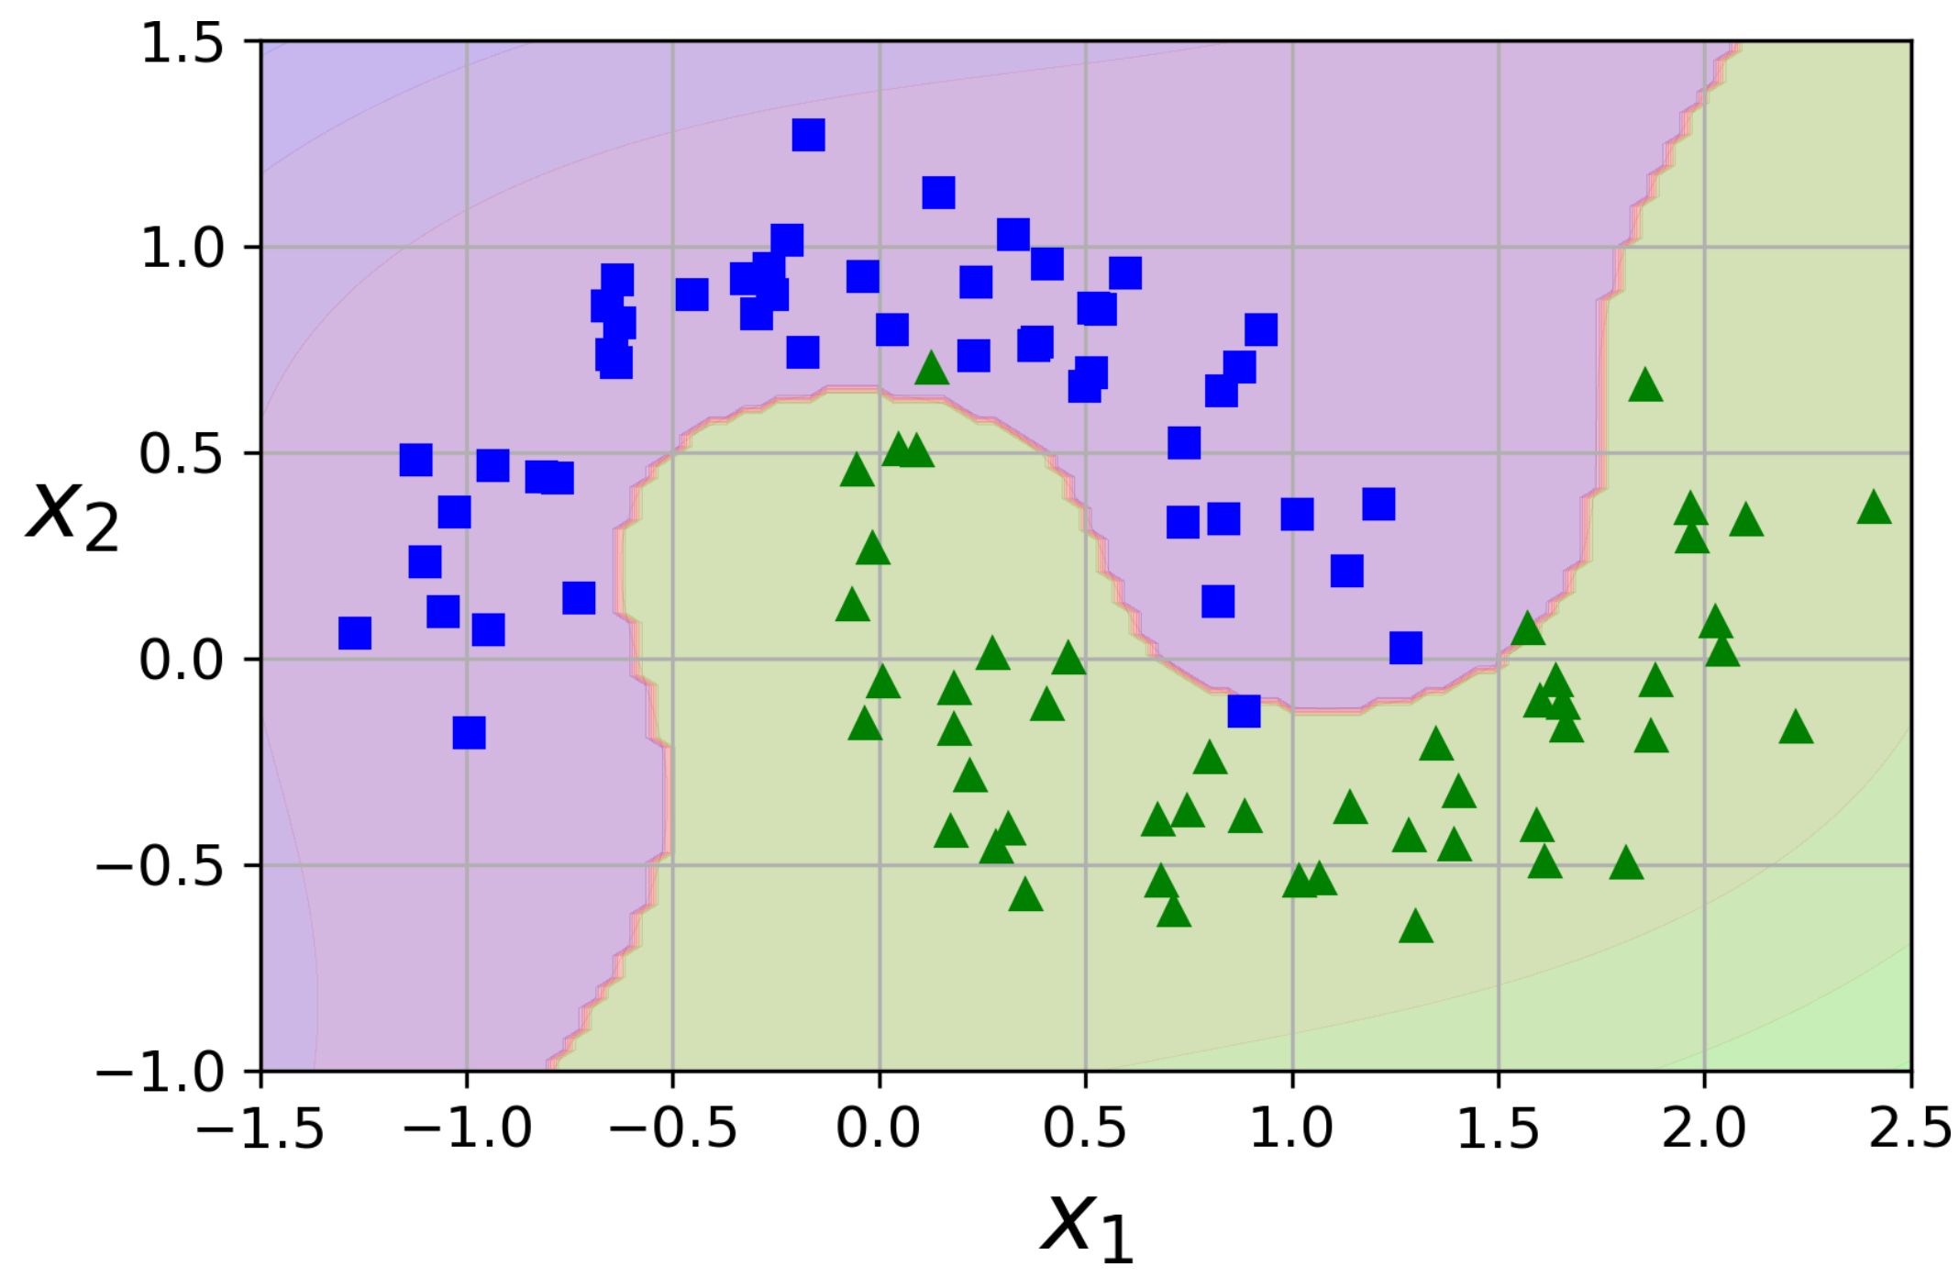
Non linear SVM

Slide 21
Non linear SVM
Although linear SVM classifiers are efficient and work surprisingly well in many cases, many datasets are not even close to being linearly separable
One approach to handling nonlinear datasets is to add more features, such as polynomial features
In some cases this can result in a linearly separable dataset

Slide 22
Non-linear SVMs
Datasets that are linearly separable with some noise work out great:
But what are we going to do if the dataset is just too hard?
How about… mapping data to a higher-dimensional space:
0
x
0
x
x²
0
x

Slide 23
Non-linear SVMs: Feature spaces
General idea: the original input space can always be mapped to some higher-dimensional feature space where the training set is separable:
Φ: x → φ(x)

Slide 24
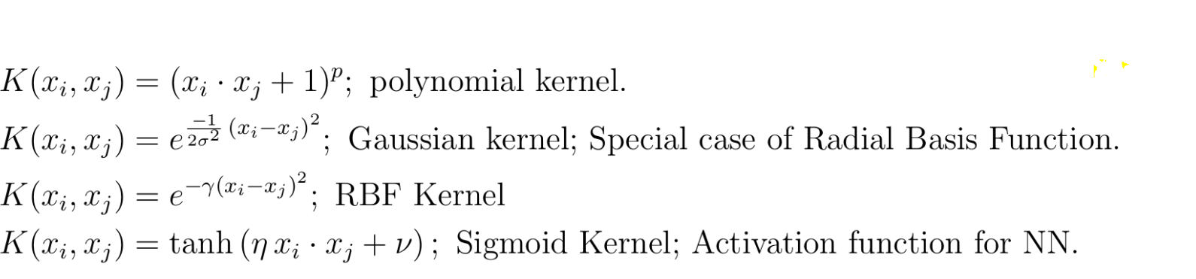
Some kernel functions

Slide 25
SVM regression
As we mentioned earlier, the SVM algorithm is quite versatile: not only does it support linear and nonlinear classification, but it also supports linear and nonlinear regression
The trick is to reverse the objective: instead of trying to fit the largest possible street between two classes while limiting margin violations, SVM Regression tries to fit as many instances as possible on the street while limiting margin violations (i.e., instances off the street)
The width of the street is controlled by a hyper-parameter ϵ.

Slide 26
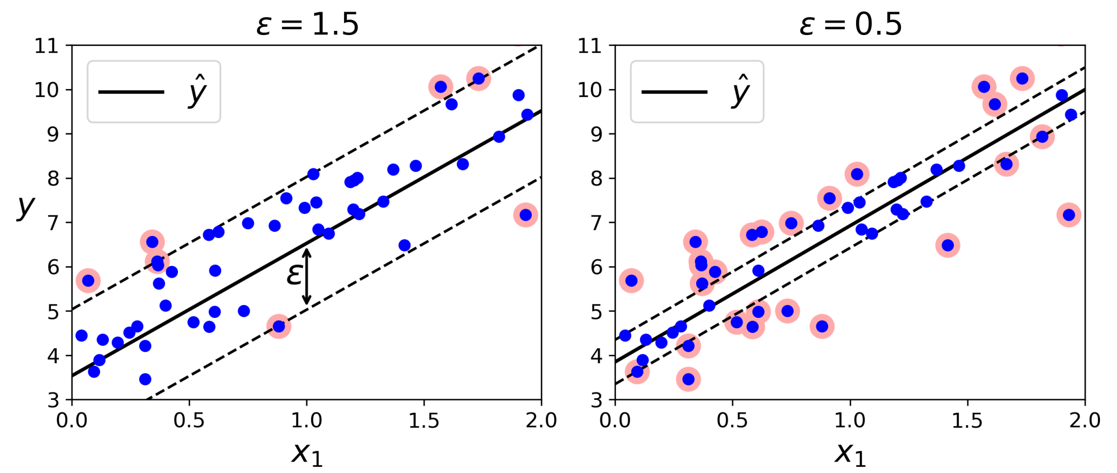
SVM regression

Slide 27
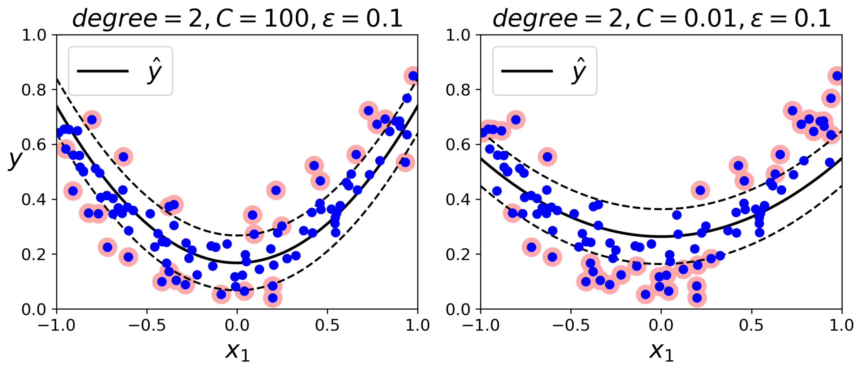
SVM regression

Slide 28
Doing multi-class classification
SVMs can only handle two-class outputs (i.e. a categorical output variable with arity 2).
How to handle multiple classes
E.g., classify documents into three categories: sports, business, politics
Answer: one-vs-all, learn N SVM’s
SVM 1 learns “Output==1” vs “Output != 1”
SVM 2 learns “Output==2” vs “Output != 2”
:
SVM N learns “Output==N” vs “Output != N”

Slide 29
One-vs-All
vs the other classes: red(d)

Slide 30
One-vs-All
vs the other classes: red(d)
vs the other classes: yellow(d)

Slide 31
One-vs-All
vs the other classes: red(d)
vs the other classes: yellow(d)
vs the other classes: cyan(d)

Slide 32
One-vs-All
vs the other classes: red(d)
vs the other classes: yellow(d)
vs the other classes: cyan(d)
Given a test document d, how to decide its color ?

Slide 33
One-vs-All
vs the other classes: red(d)
vs the other classes: yellow(d)
vs the other classes: cyan(d)
Given a test document d, how to decide its color ?
Assign d to the color function with the largest score

Slide 34
Weakness of SVM
It is sensitive to noise
- A relatively small number of mislabeled examples (especially support vectors) can dramatically decrease the performance
It only considers two classes
- how to do multi-class classification with SVM?
- Answer:
1) with output arity m, learn m SVM’s
SVM 1 learns “Output==1” vs “Output != 1”
SVM 2 learns “Output==2” vs “Output != 2”
:
SVM m learns “Output==m” vs “Output != m”
2)To predict the output for a new input, just predict with each SVM and find out which one puts the prediction the furthest into the positive region.

Slide 35
Model selection Issues
Choice of kernel
- RBF/Gaussian or polynomial kernel is default
- if ineffective, more elaborate kernels are needed
- domain experts can give assistance in formulating appropriate similarity measures
Choice of kernel parameters
- e.g. σ in Gaussian kernel
- σ is the distance between closest points with different classifications
- In the absence of reliable criteria, applications rely on the use of a validation set or cross-validation to set such parameters.
Optimization criterion – Hard margin v.s. Soft margin
- a lengthy series of experiments in which various parameters are tested

